Slide 1
CSMS role in each product development stage
General scope and purpose
Steps in each product development stage
Main role summary
IVI LD1 – Cyber Security Part

Slide 2
I. General scope and purpose
Scope of application:
These standards is applied to manage production cybersecurity requirements for products and processes from PV phase which are developed and produced in LGEVH and suppliers, and distributed by the VS company.
Purpose:
These standards clearly states the procedures and methods:
Apply the cybersecurity requirements for post-development.
Prevent the introduction of vulnerabilities during production.
This standard prepares documentations for audit plans and provide to OEMs to obtain VTA.

Slide 3
II. Steps in each product development stage
LGE
DV
PV
Pre-MP
MP
Objectives
Acquire Production
Cybersecurity Requirements
Prepare cybersecurity documentations
In compliance with requirements
Continue to update
documentations from PV
and perform assessment on Tier-2
Product Design and Development
Product and Process Validation
Mass Production
Production Control Plan (http://collab.lge.com/main/x/rOdzrQ)
Production Cybersecurity Requirements (http://collab.lge.com/main/pages/viewpage.action?pageId=3184188188)
Feasibility checking report of cybersecurity requirements. ([VSCSGU-4489] No.1 Process & Checklist - NEXT JIRA)
Applicability assessment report ([VSCSGU-4491] No.3 Process & Checklist - NEXT JIRA)
Archive assessment and inspection results ([VSCSGU-4492] No.4 Process & Checklist - NEXT JIRA)
SW Tools management process each project ([VSCSGU-4493] No.5 Process & Checklist - NEXT JIRA)
Security Tools Management category risk assessment report ([VSCSGU-4494] No.6 Process & Checklist - NEXT JIRA)
Manage cybersecurity competency tracking
Risk assessment of management processes (key management, transfer EDI, rework, … processes)
[VSCSGU-4495] No.7 Process & Checklist - NEXT JIRA
Perform vulnerability monitoring and respond incident response activity ([VSCSGU-4500] No.12 Process & Checklist - NEXT JIRA)
Continue to collect assessment and inspection results
Follow buyer audit and prepare documents.
Conduct internal audit of each project
Monitor improvement and vulnerability remediation activities
Perform assessment on Tier-2 ([VSCSGU-4501] No.13 Process & Checklist - NEXT JIRA)
CSM
Provide regular training session ([VSCSGU-4498] No.10 Process & Checklist - NEXT JIRA)
Provide process training session ([VSCSGU-4495] No.7 Process & Checklist - NEXT JIRA)
Manage and archive education completion status & cybersecurity capability status of employees.([VSCSGU-4499] No.11 Process & Checklist - NEXT JIRA)
Establish and maintain processes including TARA, vulnerability management, incident response, vendor management for all projects
Collaborate with IT/security team to verify physical access security, information security and facility security ([VSCSGU-4496] No.8 Process & Checklist - NEXT JIRA)
Monitor IT information security certificates ([VSCSGU-4497] No.9 Process & Checklist - NEXT JIRA)
Archives assessment result and inspection results as evidence for VTA ([VSCSGU-4492] No.4 Process & Checklist - NEXT JIRA)
Audit preparation and reporting
CSG
DV (Design Verification), IQ (Incoming Quality)
PV (Product Verification), OQ (Outgoing Quality)
TARA: Threat Analysis and Risk Assessment, VTA: Vehicle Type Approval

Slide 4
III. Main role summary
No | Role | Phase | Template
1 | Security part reviews production cybersecurity requirements and conduct feasibility checking whether the requirements can be applied and inspected in production line | PV
2 | Security part applies production cybersecurity requirements into production control plan and maintain the production control plan
3 | Security part performs assessment on inspection results to verify that the product is manufactured which is complying to production cybersecurity requirements in production control plan. (Ex. correct approved SW firmware/version shall be injected into product, correct keys shall be injected into product, removal of JTAG/Debug connector, secure boot enabled, sealed HW plug ,etc)
4 | Security part archives assessment result and inspection results as evidence for VTA
5 | Security part manages inventory of tools and equipment for (secure) production. (Ex. flashing software, test tools, ROM writing & Inspection tools such as Data management Software(DMS) / Tasklink / Flashcore / Lumenx FA & FCT Inspection Program)
6 | Security part performs risk assessment regarding assets such as tools & equipment for (secure) production which shall be tool version management, obtaining rationale that tools are managed by strong access control and etc.
7 | Security part understands all process from start of production to end of production (OQC) and obtains evidence with rationale in perspective of cybersecurity of every step (ROM Writing ~ key injection ~ inspection ~ OQC ~ just before shipping)
8 | Security part collaborate with IT/security team to verify physical access security, information security and facility security. | All | CSG will manage
9 | Security part monitor IT information security certificates such as TISAX, ISO 27001, IATF16949, etc
10 | Security part provides regular training session to employees, publish cybersecurity newsletter by translating to VietNam language of HQ newsletter and runs a cybersecurity campaign to enhance cybersecurity culture.
11 | Security part manages and archives education completion status & cybersecurity capability status of employees.
12 | Security part performs vulnerability monitoring on production line/system/tools and responds it as incident response activity. | MP | CSM continue to update documentations from PV and perform assessment on Tier-2
13 | Security part performs assessment on Tier-2 (tool & equipment company, outsourced production company)
Notes:
No1 and No2 have the same so we combine into one

Slide 5
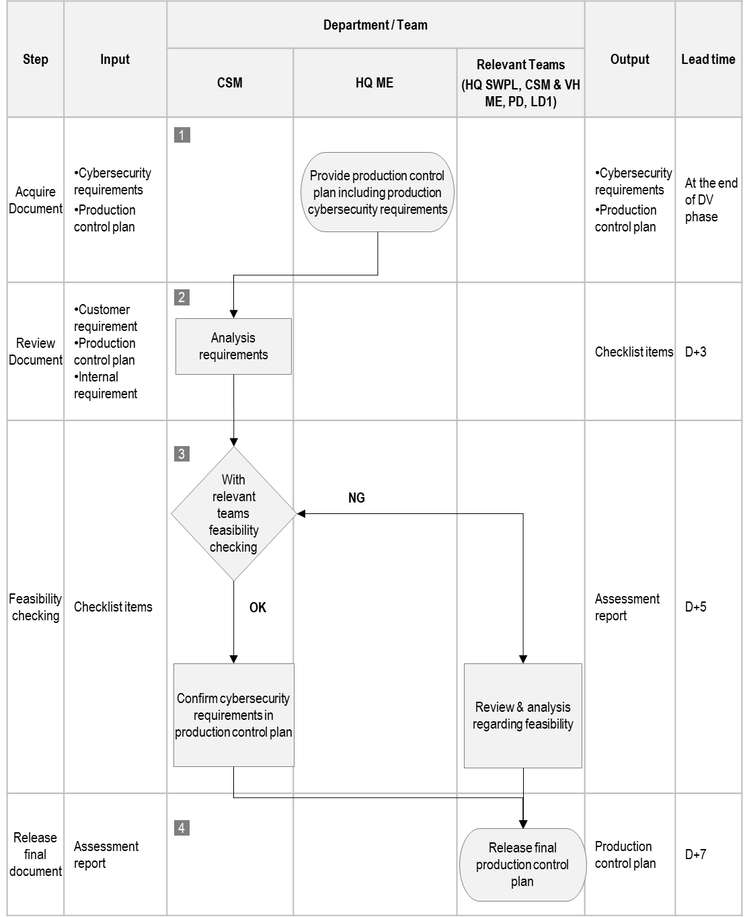
III. Main role summary
3. Feasibility checking report of cybersecurity requirements.

Slide 6
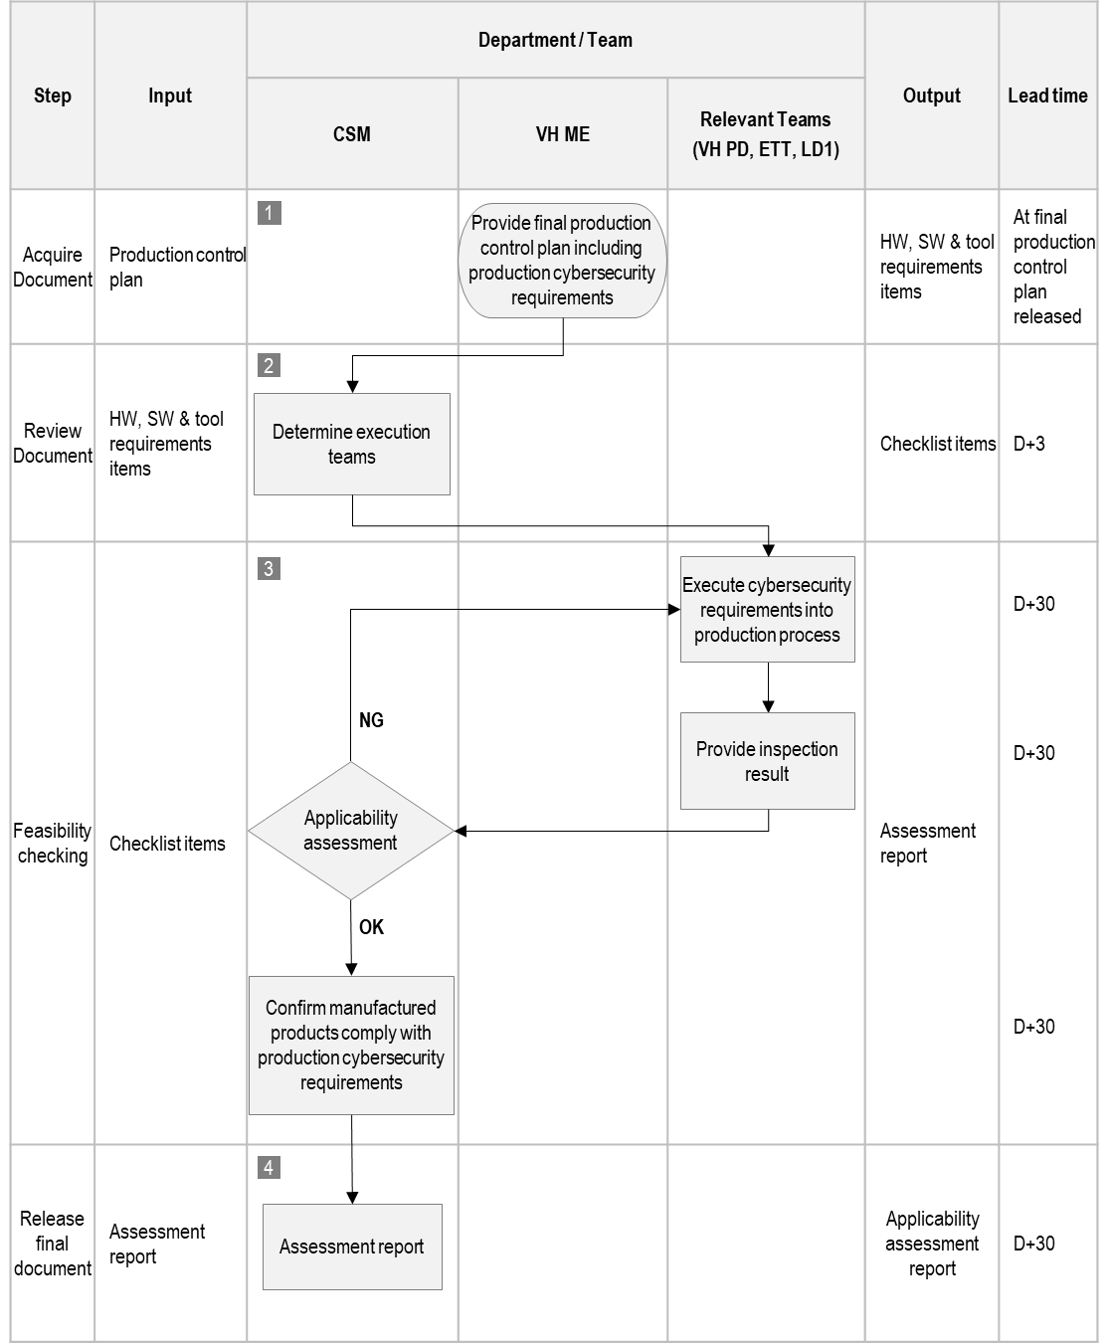
III. Main role summary
4. Applicability assessment report

Slide 7
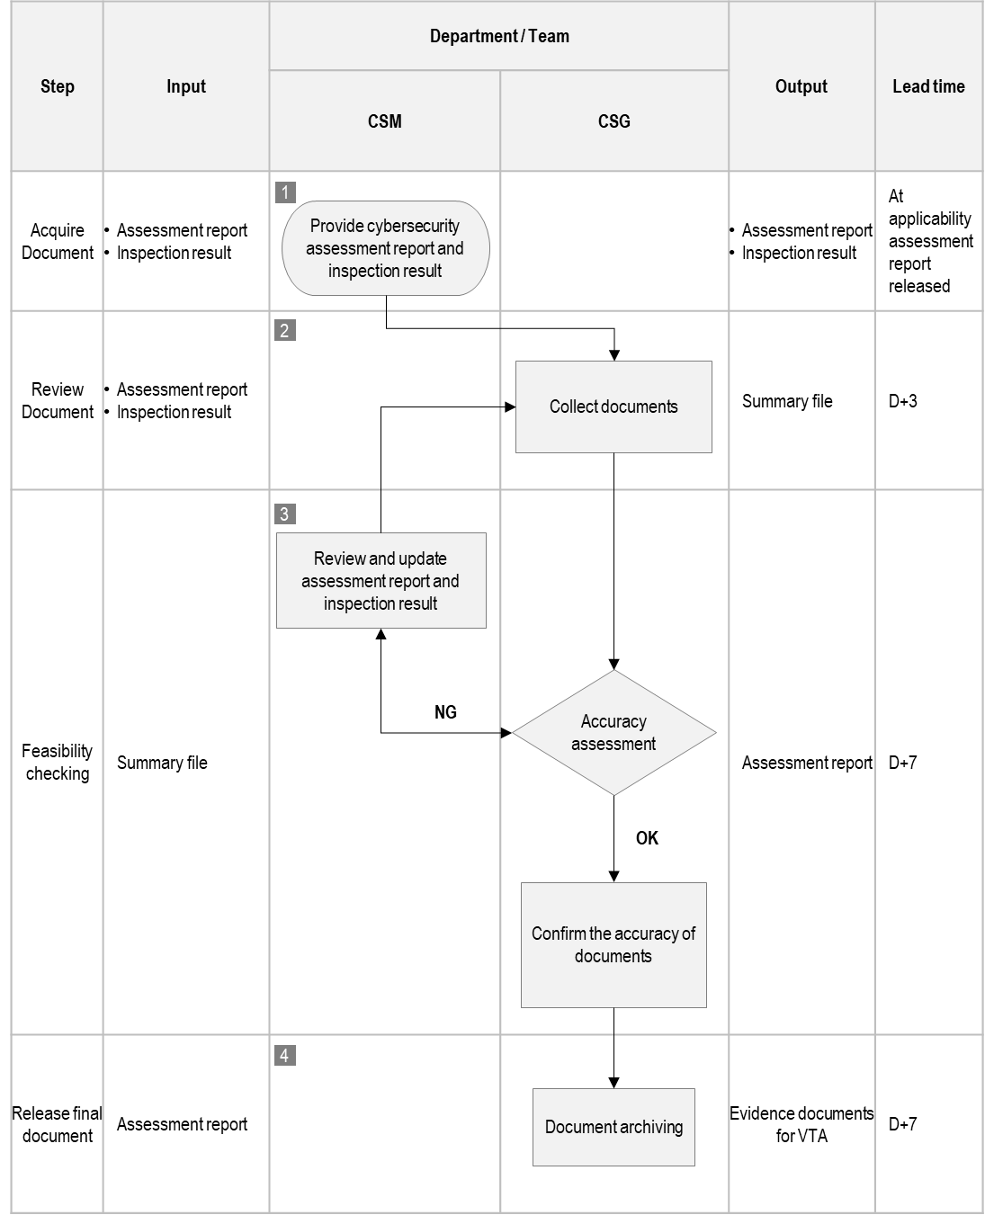
III. Main role summary
5. Archive assessment and inspection results

Slide 8
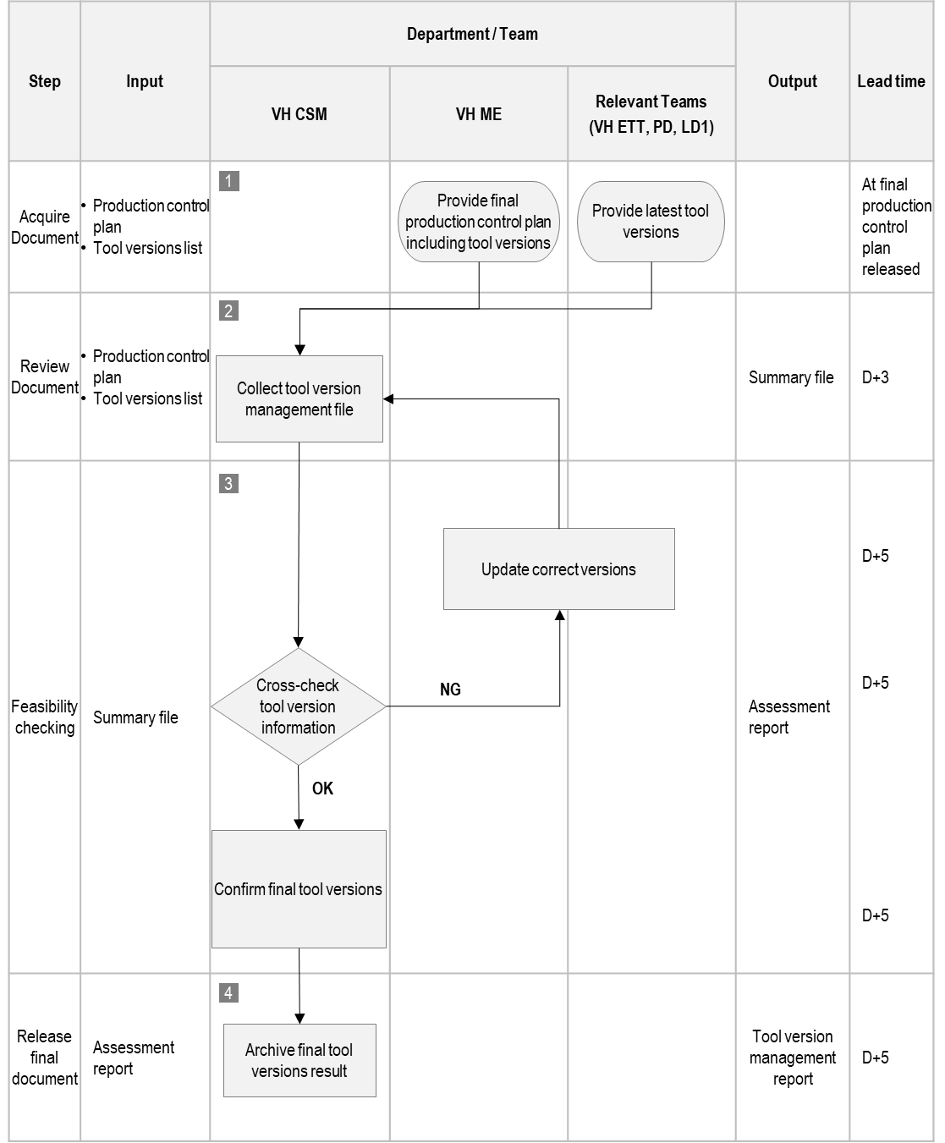
III. Main role summary
6. Secure tool management category report

Slide 9
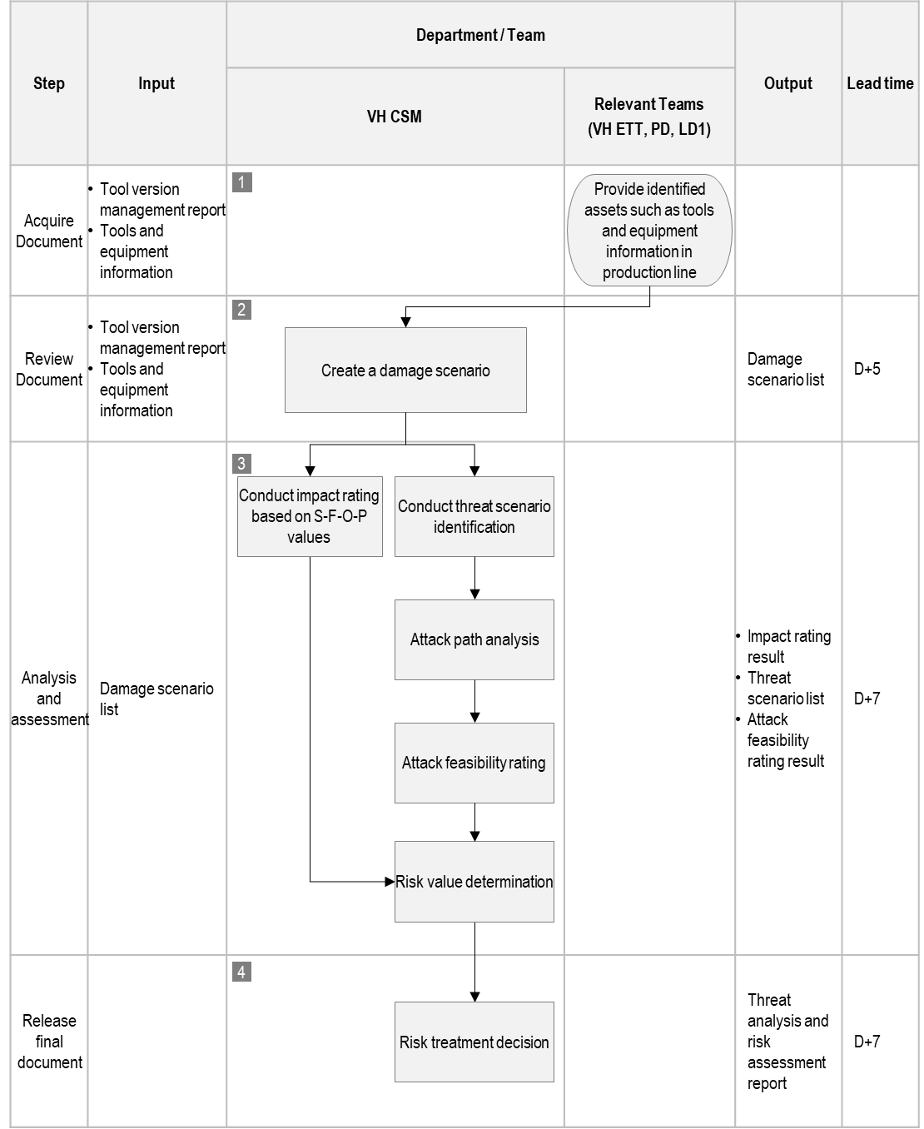
III. Main role summary
7. SW/tool management process each project

Slide 10







LGE Internal Use Only
Asset : object that has value, or contributes to value
Asset has one or more cybersecurity properties whose compromise can lead to one or more damage scenarios
Or Asset is simply something that needs to be protected by cybersecurity techniques
e.g) Headlamp system
Navigation ECU
Bluetooth
Cellular
Headlamp Switch
Gateway ECU
Considered function:
Use power switch actuator to turn the head lamp OFF and ON
The body control unit sends a message over the CAN bus to the Power Switch Actuator of the Head Lamp
Gateway controls access to the CAN bus for other ECUs
 |  | Item boundary
Headlamp Body switch control ECU Headlamp system |  |  | Power switch actuator
 | CAN
Asset | Confidentiality | Integrity | Availability
Data communication (lamp request) | - | X | X

Slide 11

LGE Internal Use Only
Damage scenario can include :
Relation between the functionality of the item and the adverse consequence
Description of harm to the road user and/or
Relevant assets
Navigation ECU
Bluetooth
Cellular
Gateway ECU
 |  | Item boundary
Headlamp Body switch control ECU Headlamp system |  |  | Power switch actuator
 | CAN
Asset | Confidentiality | Integrity | Availability | Damage scenario
Data communication (lamp request) | - | - | X | Vehicle cannot be driven at night, because the headlamp function was inhibited while parked.
 | - | X | - | Vehicle cannot be driven at night, because the headlamp function was inhibited while parked.

Slide 12

LGE Internal Use Only
Impact rating :
Assess the damage scenarios against adverse consequences for stakeholders
Depends on the point of view
*Stakeholder is a person or organization that can be affected by a damage scenario
The following impact categories have at least to be considered :
Safety impact
injuries range from life-threatening (severe) to moderate and no injuries (negligible)
Financial impact
financial damage from catastrophic (severe) to irrelevant (negligible) to the stakeholder
Operational impact
operational damage from not working (severe) to indiscernible (negligible) degradation
Privacy impact
privacy from highly sensitive (severe) information to inconveniencies (negligible)
Each damage scenario is assessed regarding Safety, Financial, Operational and Privacy (S,F,O,P) impact which results in four
values
Severe
Major
Moderate
Negligible
Impact
Damage scenario | Safety | Financial | Operational | Privacy
Vehicle cannot be driven at night, because the headlamp function was inhibited while parked. | Negligible | Negligible | Major | Negligible
Front collision with a narrow stationary object caused by unintended turning-off of headlamp during night driving at medium speed | Severe | Major | Major | Negligible

Slide 13
LGE Internal Use Only
Negative actions need to be identified that lead to a damage scenario in a threat scenario
The identification of threat scenarios :
Is a result of a team work, not by a single person
Uses a brainstorming-based approach
STRIDE
…
Threat | Description
Spoofing | Pretending of a false identity
Tampering | Manipulation of data
Repudiation | Denying an illegal action
Information Disclosure | Revealing sensitive information
Denial of Service | Making unavailable to its intended users
Elevation of Privileges | Perform an unauthorized action
STRIDE helps to consider multiple threats from different points of
view.
STRIDE is based on observation and experience.
→ Certain threats are more prevalent than others
Damage scenario
Front collision with a narrow stationary object caused by unintended turning-off of headlamp during night driving at medium speed
Threat scenario 1
Threat scenario 2
Spoofing : Attacker claims to be body control ECU and sends “Lamp request” signal
Tampering : Attacker modifies “Lamp on” to “Lamp off”

Slide 14

LGE Internal Use Only
Identifying steps for the execution of a threat scenario (= attack path)
Threat scenario 1
Necessary actions for a threat scenario
to become real
Attack Path 1a
Spoofing : Attacker claims to be body control ECU and sends “Lamp request” signal
Attacker compromises navigation ECU from cellular interface
Attack Path 1b
Navigation ECU
Bluetooth
Cellular
Compromised navigation ECU transmits malicious control signals
Gateway ECU
Attack Path 1c
Gateway ECU forwards malicious signals to power switch actuator
 |  | Item boundary
Headlamp Body switch control ECU Headlamp system |  |  | Power switch actuator
 | CAN
Attack Path 1d
Malicious signals spoof the lamp request (OFF)

Slide 15
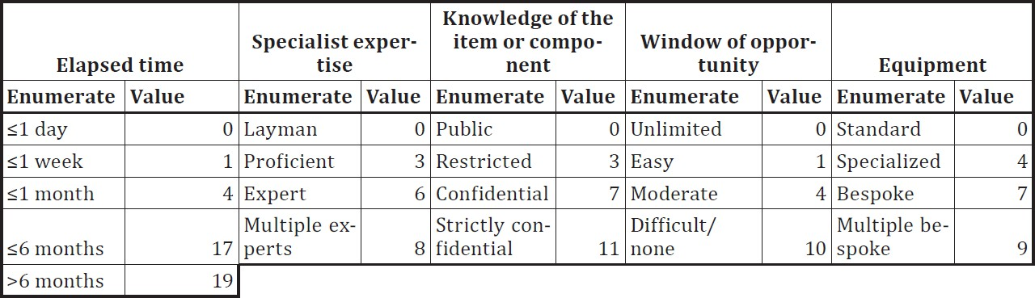
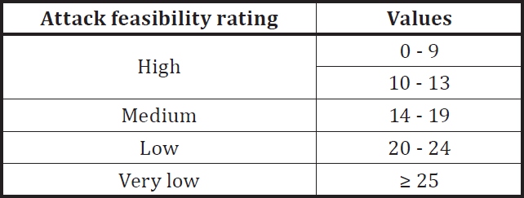
LGE Internal Use Only
The rating is based on these categories :
High : (The attack path can be accomplished utilizing) low effort
Medium : medium effort, Low : high effort, Very low : very high effort
* Kinds of attack feasibility rating approach
Attack potential-based approach
CVSS-based approach
attack vector-based approach
→ Different methods can lead to different results. One method shall be used for the rating of each attack path
Attack potential-based approach
Attack Path 1a
Attacker compromises navigation ECU from cellular interface
Attack Path 1b
Compromised navigation ECU transmits malicious control signals
= 4+6+7+1+0 = 18 → Medium
Attack Path 1c
Gateway ECU forwards malicious signals to power switch actuator
Attack Path 1d
Element | Description
Elapsed time | Time to identify a vulnerability and develop and apply an exploit
Expertise | Capabilities of the attacker, relative to their skill and experience
Knowledge of the item | Amount of information the attacker can acquire
Window of opportunity | Discover the target, access to a target, exploit works on the target, time to perform the attack on a target
Equipment | Tools the attacker has available to execute the attack
Malicious signals spoof the lamp request (OFF)

Slide 16

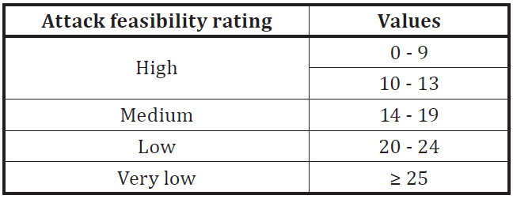
LGE Internal Use Only
Determination of the risk of a threat scenario based from the impact of the associated damage scenario and the attack
feasibility of the associated attack paths
Risk values can be determined utilizing risk matrices defined by the organization
Safety, Financial, Operational, Privacy
Drive risk value on each S,F,O,P
Risk value could be highest value among risk values on Safety, Financial, Operational and Privacy
 |  | Attack feasibility
 |  | very low | low | medium | high
Impact rating | severe | 2 | 3 | 4 | 5
 | major | 1 | 2 | 3 | 4
 | moderate | 1 | 2 | 2 | 3
 | negligible | 1 | 1 | 1 | 1
Damage scenario | Safety | Financial | Operational | Privacy
Front collision with a narrow stationary object caused by unintended turning-off of headlamp during night driving at medium speed | Severe | Major | Major | Negligible
 |  | Attack feasibility
 |  | very low | low | medium |  |  | high
Impact rating | severe | 2 | 3 |  | 4 |  | 5
 | major | 1 | 2 |  |  |  | 4
 |  |  |  |  | 3
 | moderate | 1 | 2 | 2 |  |  | 3
 | negligible | 1 | 1 |  | 1 |  | 1
Risk value
S : 4
F : 3
O : 3
P : 1

Slide 17
LGE Internal Use Only
For each threat scenario, considering its risk values, risk treatment options could be :
Avoiding the risk (by removing the risk sources)
Reducing the risk (e.g. by reducing the factors of the attack feasibility)
Sharing (Transferring)the risk (e.g. by contracts / insurances)
Retaining or Accepting the risk
Risk treatment decision might affect the mitigation measure for a threat
Risk treatment according to risk value can be defined by the organization
e.g) Risk treatment option to each risk value
Safety, Financial, Operational, Privacy
 |  | Attack feasibility
 |  | very low | low | medium | high
Impact rating | severe | 2 | 3 | 4 | 5
 | major | 1 | 2 | 3 | 4
 | moderate | 1 | 2 | 2 | 3
 | negligible | 1 | 1 | 1 | 1
Risk value | Risk treatment option
5 | avoiding the risk / reducing the risk
4 | reducing the risk
3 | reducing the risk
2 | sharing or transferring the risk
1 | accepting or retaining the risk

Slide 18
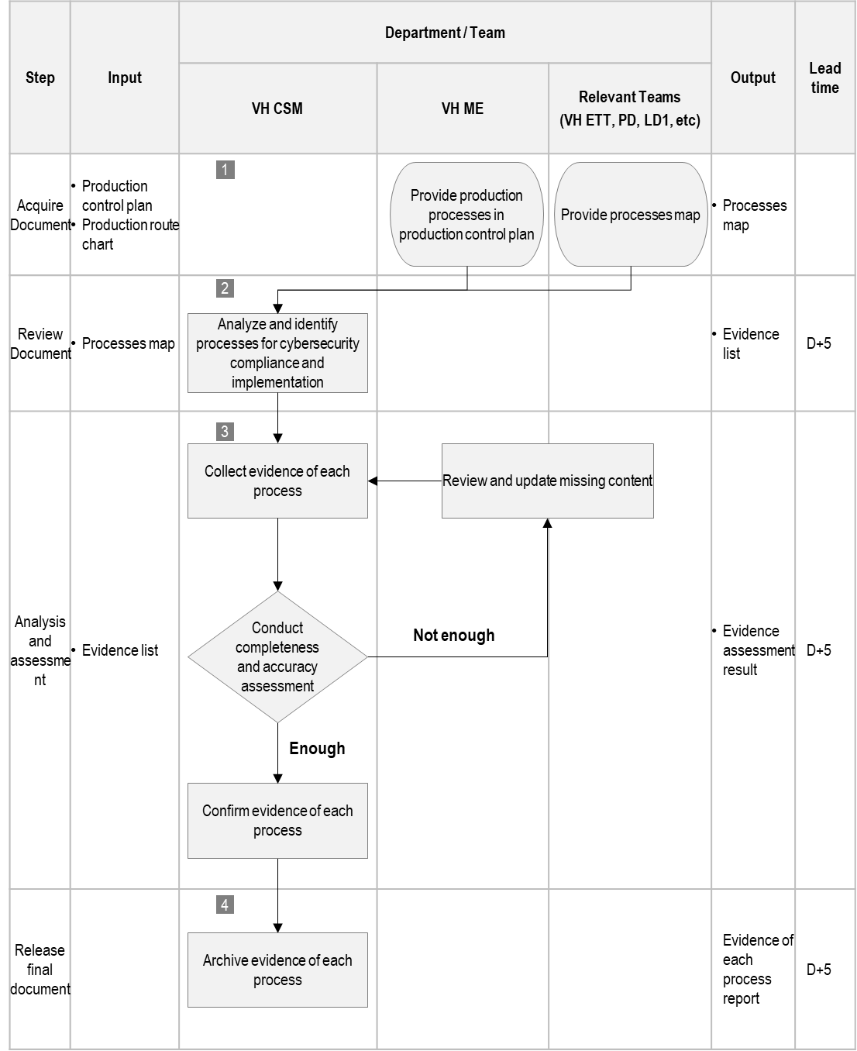
III. Main role summary
9. Risk assessment of management processes

Slide 19
Thank you

